Slide 1
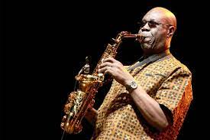
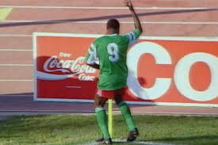
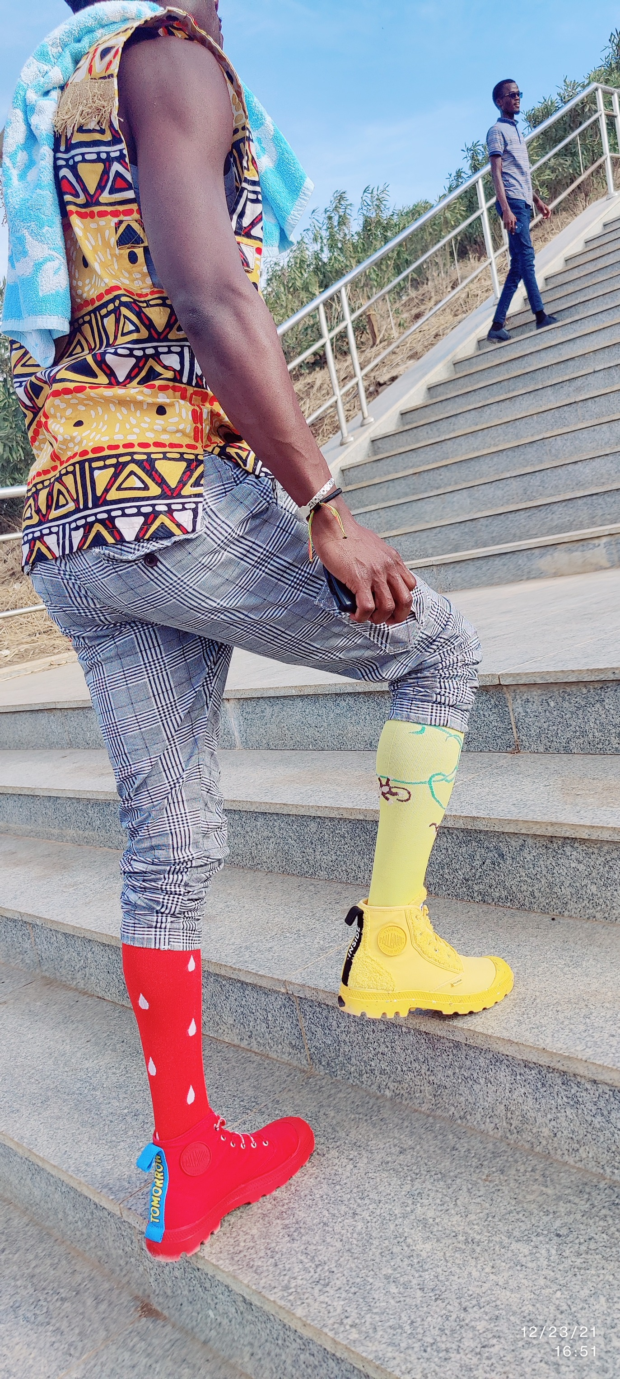
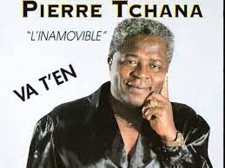
Manu Dibango
plagiarised by Michael Jackson
(“mamasa mamako mamamakossa”)
Roger Milla
Wold cup’90
Alain Tchana
Dakar 2021
Pierre Tchana
Salsa

Slide 2

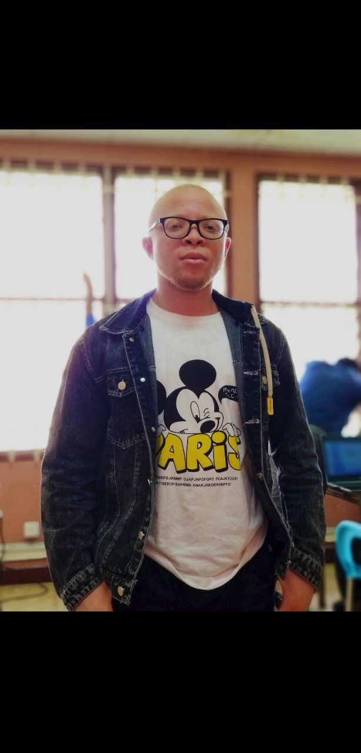

R. Colin
R. Colin
B. Teguia
S. Bitchebe
B. Teguia
S. Bitchebe

Slide 3
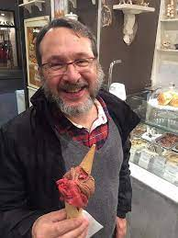
OoH is it
principle, concept,
abstraction, etc???

